Slide 1
Spring Boot
Pet Park Locations: Create table entities

Slide 2
In this video...
A look at the Pet Park Locations Entity Relationship Diagram (ERD)
Create the entities that Spring Java Persistence API (Spring JPA) will use to create the schema tables

Slide 3
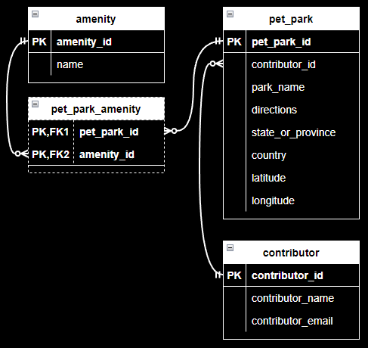
Here's what we're building
JPA will create the tables for us

Slide 4
Create the JPA table entities
@Entity
@Data
public class Contributor {
@Id
@GeneratedValue(strategy = ...)
private Long contributorId;
@Column(unique = true)
private String contributorEmail;
@OneToMany(mappedBy = ...)
private Set<PetPark> petParks;
}

Slide 5
Embed an object in an entity
@Entity
public class PetPark {
@Embedded
private GeoLocation geolocation;
}
@Embeddable
public class GeoLocation {
}

Slide 6
Let's get started!

